Slide 1
Homework 1
Max: 100
Min: 64
Median: 100
Average: 92.9
# of 100: 68
Project 2
Max: 100
Min: 30
Median: 96
Average: 82.8
# of 100: 32
Project 1
Max: 100
Min: 24
Median: 99
Average: 89.3
# of 100: 40

Slide 2
COMP 3500 Introduction to Operating Systems Project 3 – Part 2 (cont.): Condition Variables
Dr. Xiao Qin
Auburn University http://www.eng.auburn.edu/~xqin
xqin@auburn.edu
Notes:
Locks: 25 Minutes. Slides 1-7
Condition Variables: 25 Minutes. Slides 8-15
To be continued: slides 16.

Slide 3
Version 1.0: The Producer/Consumer Problem – No Concurrency Control
char buffer[SIZE];
int count = 0, head = 0, tail = 0;
static struct lock *mutex;
mutex = lock_create(“mutex for cv”);
void producer(char c) {
lock_acquire(mutex);
count++;
buffer[head] = c;
head++;
if (head == SIZE) {
head = 0;
}
lock_release(mutex);
}
char consumer() {
char c;
lock_acquire(mutex);
count--;
c = buffer[tail];
tail++;
if (tail == SIZE) {
tail = 0;
}
lock_release(mutex);
return c;
}
Notes:
Let’s consider the producer/consumer sample to show how to use condition variables
We start this example with locks.
3. No need to use static here; just a demonstration

Slide 4
Version 2.0: The Producer/Consumer Problem Concurrency Control with Busy Waiting
char consumer() {
lock_acquire(mutex);
while (count == 0) {
lock_release(mutex);
lock_acquire(mutex);
}
count--;
c = buffer[tail];
tail++;
if (tail == SIZE) {
tail = 0;
}
lock_release(mutex);
return c;
}
void producer(char c) {
lock_acquire(mutex);
while (count == SIZE)
{
lock_release(mutex);
lock_acquire(mutex);
}
count++;
buffer[head] = c;
head++;
if (head == SIZE)
{
head = 0;
}
lock_release(mutex);
}
Which lock_acqure() and lock_release() are a pair?
Notes:
Which lock_acqure and lock_release are a pair?

Slide 5
From Version 2.0: Concurrency Control with Busy Waiting To Version 3.0: Concurrency Control with Sleeping
void producer(char c) {
lock_acquire(mutex);
while (count == SIZE)
{
lock_release(mutex);
lock_acquire(mutex);
}
count++;
buffer[head] = c;
head++;
if (head == SIZE)
{
head = 0;
}
lock_release(mutex);
}
void producer(char c) {
lock_acquire(mutex);
while (count == SIZE) {
cv_wait(notFull, mutex);
}
count++;
buffer[head] = c;
head++;
if (head == SIZE) {
head = 0;
}
cv_signal(notEmpty, mutex);
lock_release(mutex);
}

Slide 6
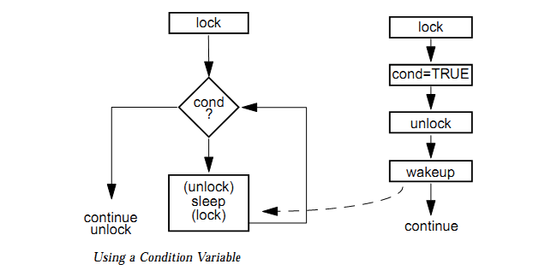
Condition Variables
void producer(char c) {
lock_acquire(mutex);
while (count == SIZE) {
cv_wait(notFull, mutex);
}
count++;
buffer[head] = c;
head++;
if (head == SIZE) {
head = 0;
}
cv_signal(notEmpty, mutex);
lock_release(mutex);
}
Reference: http://blog.csdn.net/imyfriend/article/details/7590547

Slide 7
Exercise 5. Please complete the consumer code using condition variables.
char consumer() {
char c;
lock_acquire(mutex);
while (count == 0) {
cv_wait(notEmpty, mutex);
}
count--;
c = buffer[tail];
tail++;
if (tail == SIZE) {
tail = 0;
}
cv_signal(notFull, mutex);
lock_release(mutex);
return c;
}
void producer(char c) {
lock_acquire(mutex);
while (count == SIZE) {
cv_wait(notFull, mutex);
}
count++;
buffer[head] = c;
head++;
if (head == SIZE) {
head = 0;
}
cv_signal(notEmpty, mutex);
lock_release(mutex);
}

Slide 8
Condition Variables: Data Structure
Wait until a variable meets a particular condition
There is no actual variable in the CV
/* kern/include/synch.h */
struct cv {
char *name;
// add what you need here
};
Notes:
There is little information on condition variables in the textbook

Slide 9
How to implement cv_wait()?
void cv_wait(struct cv *cv, struct lock *lock) {
use assert to check input cv and lock;
turn off interrupts;
release the lock;
/*Question: thread_sleep() using cv or lock?*/
sleep the thread until someone signals cv;
acquire the lock;
turn on interrupts to the previous level;
}
Notes:
cv shouldn’t be NULL
lock shouldn’t be NULL
Wait for cv do not wait for lock
Thread_sleep
Using cv

Slide 10
How to implement cv_signal()?
void cv_signal(struct cv *cv, struct lock *lock) {
use assert to check cv and lock;
turn off interrupts;
/* Question: How to implement the following IF */
if (this thread does not hold lock)
panic("cv_signal error: cv %s at %p, lock %s at
%p.\n", cv->name, cv, lock->name, lock);
/* see also how to wakeup a thread Slide 15 */
wakeup one thread using indicator “cv”;
turn on interrupts to the previous level;
}
Notes:
cv shouldn’t be NULL
lock shouldn’t be NULL

Slide 11
Condition Variables: Sample Usage
/* Declare a cv */
static struct cv *sample_cv;
/* Initialize the cv */
sample_cv = cv_create(”sample cv");
if (sample_cv == NULL) /* Why panic? */
panic(”sample_cv: Out of memory.\n");
/* Destroy the cv in the end */
cv_destroy(sample_cv);
sample_cv = NULL;
cv_wait(sample_cv, sample_lock); /* Wait */
cv_signal(sample_cv, sample_lock); /* Signal */

Slide 12
The Producer/Consumer Problem How to use condition variables in OS/161?
char buffer[SIZE];
int count = 0, head = 0, tail = 0;
static struct lock *mutex;
static struct cv *notEmpty;
static struct cv *notFull;
mutex = lock_create(“mutex for cv”);
if (mutex == NULL)
panic(”mutex: Out of memory.\n");
notEmpty = cv_create(“Buffer not empty”);
notFull = cv_create(“Buffer not full”);
if (notEmpty == NULL || notFull == NULL)
panic(”CV: Out of memory.\n");
Notes:
Which lock_acqure and lock_release are a pair?

Slide 13
Summary
Handle the empty/full cases using locks
Condition Variables: Data Structure
How to implement cv_wait()?
How to implement cv_signal()?

Slide 14
COMP 3500 Introduction to Operating Systems Synchronization: Part 4 (cont.) Classical Synchronization Problems
Dr. Xiao Qin
Auburn University http://www.eng.auburn.edu/~xqin
xqin@auburn.edu
Notes:
Spring’17:
Slides 1-5: 25 Minutes
Slides 6-13: 25 Minutes

Slide 15

The Readers-Writers Problem
Concurrent processes
Readers – only read data; do not perform updates
Writers – both read and write
Problem:
Allow multiple readers to read at the same time
Only one single writer can access the shared data
Notes:
A data set is shared among a number of concurrent processes
Readers – only read the data set; they do not perform any updates
Writers – can both read and write
Problem – allow multiple readers to read at the same time
Only one single writer can access the shared data at the same time
Several variations of how readers and writers are considered – all involve some form of priorities
Shared Data
Data set
Semaphore rw_mutex initialized to 1
Semaphore mutex initialized to 1
Integer read_count initialized to 0

Slide 16
Other Readers-Writers Problems
Problem 1: no reader kept waiting unless writer has permission to use shared object
Problem 2: once writer is ready, it performs the write ASAP
Both may have starvation
Notes:
Problem is solved on some systems by kernel providing reader-writer locks

Slide 17
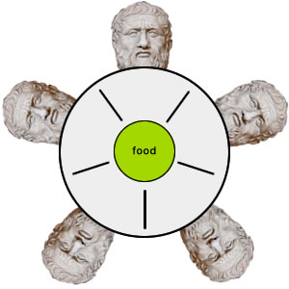
Exercise 1: Can you solve the dining-philosopher problem?
Exercise 1.1 (Plickers): What are the initial values of semaphore array chopstick[5]?
chopstick[0]= … chopstick[4] = 0;
chopstick[0]= … chopstick[3] = 1; chopstick[4]= 0;
chopstick[0]= … chopstick[3] = 0; chopstick[4]= 1;
chopstick[0]= … chopstick[4] = 1;
Philosophers spend their lives thinking and eating
Occasionally try to pick up 2 chopsticks (one at a time) to eat from bowl
In the case of 5 philosophers: Shared data
Bowl of rice
Semaphore chopstick [5]
Notes:
Philosophers spend their lives alternating thinking and eating
Don’t interact with their neighbors, occasionally try to pick up 2 chopsticks (one at a time) to eat from bowl
Need both to eat, then release both when done
In the case of 5 philosophers
Shared data
Bowl of rice (data set)
Semaphore chopstick [5] initialized to 1

Slide 18
The structure of Philosopher i
/* After */
do {
wait (chopStick[ (i + 1) % 5] );
wait (chopstick[i] );
// eat
signal (chopstick[ (i + 1) % 5] );
signal (chopstick[i] );
// think
} while (TRUE);
/* Before */
do {
wait (chopstick[i] );
wait (chopStick[ (i + 1) % 5] );
// eat
signal (chopstick[i] );
signal (chopstick[ (i + 1) % 5] );
// think
} while (TRUE);
Exercise 1.2 (Plickers): Can you switch the order of the two chopsticks?
No
Yes
Sometimes
Depends

Slide 19
Exercise 2: What is the problem with this algorithm?
do {
wait (chopstick[i] );
wait (chopStick[ (i + 1) % 5] );
// eat
signal (chopstick[i] );
signal (chopstick[ (i + 1) % 5] );
// think
} while (TRUE);

Slide 20
Deadlock Handling
Allow at most 4 philosophers to be sitting simultaneously at the table.
Allow a philosopher to pick up the forks only if both are available (picking must be done in a critical section.
Use an asymmetric solution -- an odd-numbered philosopher picks up first the left chopstick and then the right chopstick. Even-numbered philosopher picks up first the right chopstick and then the left chopstick.

Slide 21
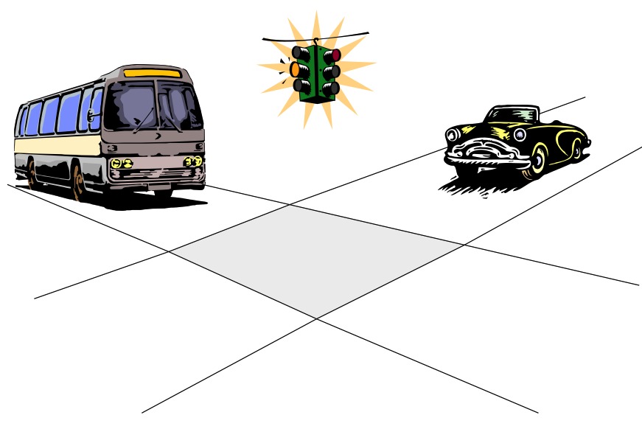
Problems with Semaphores
Incorrect use of semaphore operations:
signal (mutex) …. wait (mutex)
wait (mutex) … wait (mutex)
Omitting of wait (mutex) or signal (mutex) (or both)
Deadlock and starvation are possible.
Notes:
Inverse order: signal(mutex) wait(mutex)
Repeate calls: wait, wait
Omitted calls.

Slide 22
Summary
The Dining-Philosophers Problem
Notes:
Summary of Chapter 5.

Slide 23
Pthreads
Notes:
Reference: https://en.wikipedia.org/wiki/POSIX_Threads
POSIX Threads, usually referred to as Pthreads, is an execution model that exists independently from a language, as well as a parallel execution model. It allows a program to control multiple different flows of work that overlap in time. Each flow of work is referred to as a thread, and creation and control over these flows is achieved by making calls to the POSIX Threads API. POSIX Threads is an API defined by the standard POSIX.1c, Threads extensions (IEEE Std 1003.1c-1995).
Implementations of the API are available on many Unix-like POSIX-conformant operating systems such as FreeBSD, NetBSD,OpenBSD, Linux, Mac OS X and Solaris, typically bundled as a library libpthread. DR-DOS and Microsoft Windows implementations also exist: within the SFU/SUA subsystem which provides a native implementation of a number of POSIX APIs, and also within third-party packages such as pthreads-w32,^{[1]} which implements pthreads on top of existing Windows API.
pthread.h

Slide 24
Notes:
On success, pthread_create() returns 0; on error, it returns an error number, and the contents of *thread are undefined.

Slide 25
Implementing Semaphores Using Pthreads Exercise 3: What is the value item in the following structure? Why we need a lock?
Notes:
Reference: https://en.wikipedia.org/wiki/POSIX_Threads
POSIX Threads, usually referred to as Pthreads, is an execution model that exists independently from a language, as well as a parallel execution model. It allows a program to control multiple different flows of work that overlap in time. Each flow of work is referred to as a thread, and creation and control over these flows is achieved by making calls to the POSIX Threads API. POSIX Threads is an API defined by the standard POSIX.1c, Threads extensions (IEEE Std 1003.1c-1995).
Implementations of the API are available on many Unix-like POSIX-conformant operating systems such as FreeBSD, NetBSD,OpenBSD, Linux, Mac OS X and Solaris, typically bundled as a library libpthread. DR-DOS and Microsoft Windows implementations also exist: within the SFU/SUA subsystem which provides a native implementation of a number of POSIX APIs, and also within third-party packages such as pthreads-w32,^{[1]} which implements pthreads on top of existing Windows API.

Slide 26
Implementing wait()
Notes:
Reference: https://en.wikipedia.org/wiki/POSIX_Threads
POSIX Threads, usually referred to as Pthreads, is an execution model that exists independently from a language, as well as a parallel execution model. It allows a program to control multiple different flows of work that overlap in time. Each flow of work is referred to as a thread, and creation and control over these flows is achieved by making calls to the POSIX Threads API. POSIX Threads is an API defined by the standard POSIX.1c, Threads extensions (IEEE Std 1003.1c-1995).
Implementations of the API are available on many Unix-like POSIX-conformant operating systems such as FreeBSD, NetBSD,OpenBSD, Linux, Mac OS X and Solaris, typically bundled as a library libpthread. DR-DOS and Microsoft Windows implementations also exist: within the SFU/SUA subsystem which provides a native implementation of a number of POSIX APIs, and also within third-party packages such as pthreads-w32,^{[1]} which implements pthreads on top of existing Windows API.

Slide 27
Implementing signal()
Notes:
Reference: https://en.wikipedia.org/wiki/POSIX_Threads
POSIX Threads, usually referred to as Pthreads, is an execution model that exists independently from a language, as well as a parallel execution model. It allows a program to control multiple different flows of work that overlap in time. Each flow of work is referred to as a thread, and creation and control over these flows is achieved by making calls to the POSIX Threads API. POSIX Threads is an API defined by the standard POSIX.1c, Threads extensions (IEEE Std 1003.1c-1995).
Implementations of the API are available on many Unix-like POSIX-conformant operating systems such as FreeBSD, NetBSD,OpenBSD, Linux, Mac OS X and Solaris, typically bundled as a library libpthread. DR-DOS and Microsoft Windows implementations also exist: within the SFU/SUA subsystem which provides a native implementation of a number of POSIX APIs, and also within third-party packages such as pthreads-w32,^{[1]} which implements pthreads on top of existing Windows API.

Slide 28
Thread Synchronization
Multiple threads try to access the same resource
Example: one thread writes a file, one thread is opening the same file, and a third one might be closing the same file.
Both may have starvation
Notes:
Java, C#, C, C++,

